Slide 1
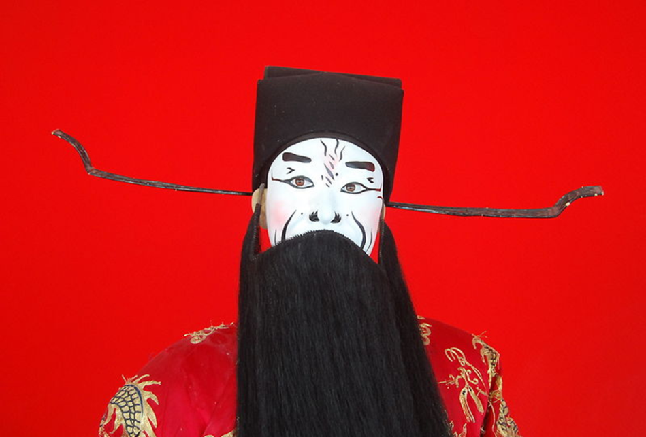
The Decline of the Han Empire and The Period of Disunion (220-589)

Slide 2
Political Change Before and After the Han
HAN DYNASTY
Strong Central Court
Rule by Empire
North as Political Center
http://www.youtube.com/watch?v=vr-40YlPr90
THREE KINGDOMS
(ca. 220-263)
Many Separate Kingdoms seeking Reunification
Cao Cao (155-220): a cruel, ambitious leader for Wei Kingdom (220-265) (also known as a great poet!).
Zhuge Liang (181-234): famous minister and tactician for Shu Han Kingdom (221-263).
Political Competition Between North and South

Slide 3
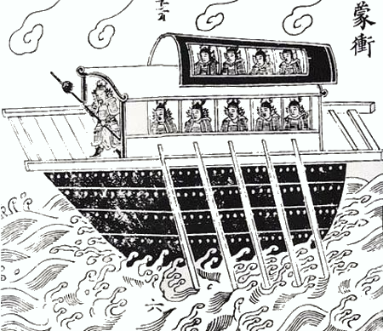

Slide 4
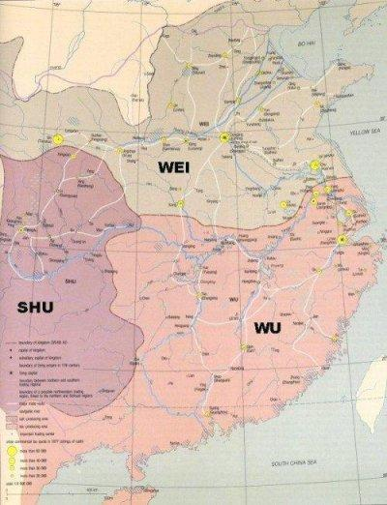
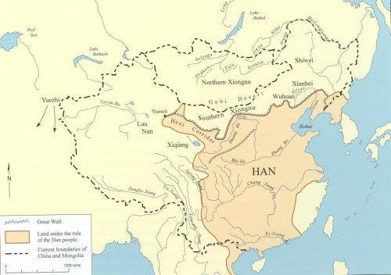
Map of the Han &
Map of the Period of Disunion

Slide 5
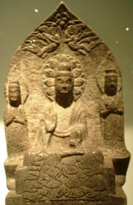
Further Fragmentation of Empire
Xian Bei: tribal group (devout Buddhists) that ruled the Northern Wei Dynasty (386-535).
Six Dynasties (317-589): wealthy families fled to the South to set up new bases of power.
Image source: http://en.wikipedia.org/wiki/Eastern_Wei

Slide 6
Social Changes
Court-centered Society
Court & Imperial Family as Dominant Social Force
Statecraft Confucianism
Promotion by Merit
Aristocracy-centered Society
Local Aristocracy as Dominant Social Force
Rise of "Localized" Confucianism
Promotion by Social Standing
Nine Ranks System: method first employed during the Three Kingdoms period of recruiting and evaluating good officials through the recommendations of a "worthy" Senior Rectifier.

Slide 7
Han values cast aside
Matchmakers now necessary for making linkages between aristocratic families.
A woman could have only one husband during her lifetime; another idea promoted by aristocratic families to protect holdings.
These values now written into the law code, not true during the Han dynasty.

Slide 8
Equal Field System
In 484 the Northern Wei court looked for areas where land was abundant and called up peasant families to use this land (lots of 20 mu each) on contract (20% of it was given to families for long-term investment).
These peasants paid taxes. The state owned all the land, and wished to prevent large manors from hoarding the land.
Peasants obliged to serve in military (militia system).
System lasted from 480s to 720s.

Slide 9
Social Shifts during the Period of Disunion
Aristocracy and "han men" (a household without enough heat) families that were sufficiently wealthy to educate their sons to serve in the lower level of the bureaucracy, but could not consider themselves part of the bureaucracy.
Free peasants; this group declined during this period.
Peasants with dependent status; slaves and "guests" both existed during this period, however "guests" could not be given away.
Bu chu: private retainers; men who were armed and retained by large land-owning families, not entirely free to go. Part of private armies often.
*Note that the aristocracy was not entirely closed, but nearly so.

Slide 10
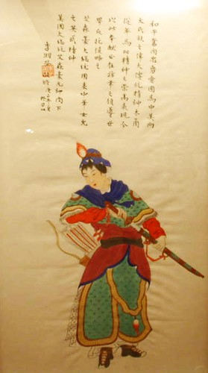
“Ballad of Mulan”
Composed in this period, creating a very different (but atypical) public image for women.

Slide 11
Transformation of Confucianism
Common belief that Confucianism was eclipsed by Buddhism and Daoism during the Period of Disunion, however...
Confucianism was codified during this period.
Confucianism at this stage emphasized human relationships; aristocracy stressed relationship-based when acting in their own social behavior.
The intellectual exercise of “pure conversation (qing tan)” became very popular by the early 4th century. This display of learned wit and conversational skills became a method of debate preferred by early Buddhists.

Slide 12
Transformation of Daoism
No longer the simple philosophy of Lao Zi.
  Alchemy
  popular religions and deities adopted by local Daoist priests; the "local" nature of Daoism persists until the present day.
Growth of literary tradition in Daoism; Daoist texts came into existence often by revelation
Daoism took from Han Confucianism the Yin-yang and the Five Elements (wu xing) ideas. The followers of Daoism heralded the arrival of Buddhism in China.

Slide 13
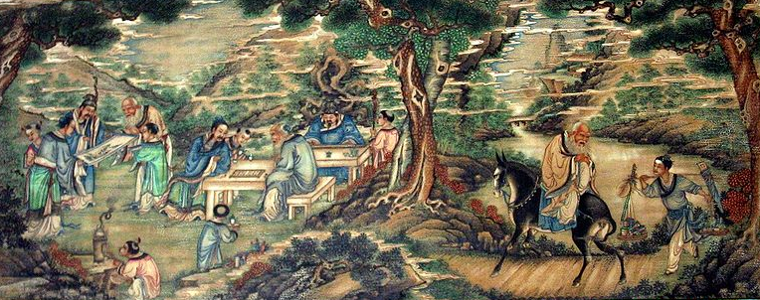
“Seven Sages of the Bamboo Grove”
The group of scholars led by Xi Kang (223-62), who gathered to celebrate their group “bohemian” identity. Their behavior outraged conservative Confucians, and Xi was actually executed for the perversion of public morals.

Slide 14
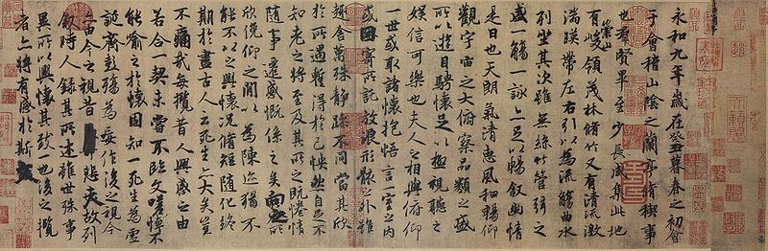
Wang Xizhi 王羲之(c. 307-65)
The famous calligrapher, who drew his inspiration from Daoist-influenced visions of nature.

Slide 15
General trends in China during this “period of disunion”
1. Absence of single political order.
2. Economy slides backward. Reduction of product specialization and trading patterns. Coinage system throughout China became erratic, in some area rolls of silk became the monetary unit.
3. Elite status is closed.
4. More slaves. lower classes.
5. Introduction of Confucian ideas into the law code. The state now says how one should be a good Confucian (discussed later).
6. Emergence of Buddhism (discussed later).

